Slide 1



COTS Communication Drill Training

Slide 2
Training Objectives (Course materials on https://www.cotshealth.org/cots-university)
1. COTS Emergency Preparedness & Response Overview. COTS EP POC.
4. Different types of exercises that are required
5. After Action Follow Up Process
2. Brief overview of the communication systems
3. Radio Etiquette

Slide 3





COTS Emergency Preparedness Staff
Kelsey Blackburn, CHEP Regional Healthcare Coordinator SE/SEC Region
Jodi Keller, RN Regional Healthcare Coordinator Central Region
Melissa Rose, MEP
Healthcare Training and Exercise Planner
Igor Hadzisulejmanovic
Regional Healthcare Coalition Coordinator SE/SEC Region
Arin Tracy
Regional Healthcare Coalition Coordinator Central Region

Slide 4
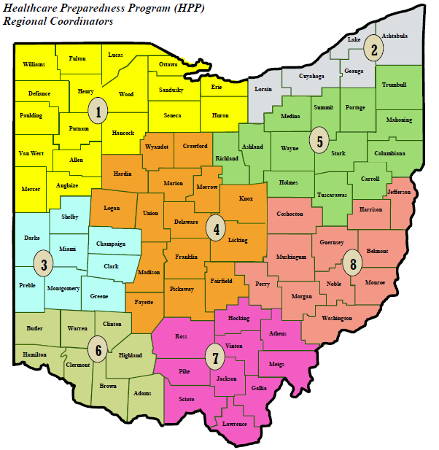
COTS Preparedness Regions
Regions 7 & 8 Southeast/Southeast Central
21 Counties
17 hospitals (16 ASPR participating)
4 FSEDs
  2 Level III Trauma Centers
200 Healthcare Partners
Region 4 Central (Homeland Security Region IV)
15 Counties
27 ASPR participating hospitals
6 Trauma Centers
14 Acute Care Hospitals
7 Critical Access
700+ partners
Per the PA Agreement: The Hospital is a healthcare coalition member as long as they are active in their regional/local healthcare coalition
Notes:
Also talk about the Coalition Partners here.

Slide 5
COTS Emergency Preparedness Point of Contact
Do you know who your COTS Emergency Preparedness Point of Contact is?

Slide 6
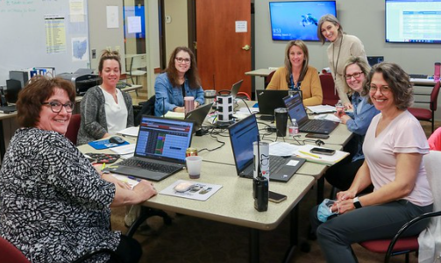
Healthcare Incident Liaison
The COTS HIL is a 24/7 Service for the Regional Healthcare Emergency Preparedness (RHEP) Coalition and the SE/SEC Ohio Healthcare Coalition (SEOHC)
Coordinate's healthcare response to disasters:
  Clearinghouse for information
  Resource Allocation
  Inter-Facility Communication
  Liaison to the State
There are two ways to page the HIL:
1. Dial 1-855-266-7243 and enter ID: 26874451 (COTSHIL1). Be sure to enter/verify your contact phone number.
2. Send an email to 26874451@onpage.com
Notes:
1 staff person carries a pager 24/7 365

Slide 7
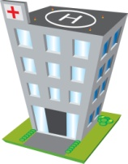


COTS HIL RESPONSE MODE
POC
Beds
Resources
Capacity
Capability
HELP!!
COTS HIL
TENS
Assistance
Besides the systems we use, we conduct a conference call when needed to discuss situational awareness, information sharing, resource allocation, and any additional planning/actions needed.
Local, Regional, State, Federal Resources
Notes:
Local = EMA, ARC, Public Health,
Regional = Caches, Hospitals

Slide 8
Examples of types of Incidents
Short term – Less than 12 hours
  Power outages
  Flood causing an area of the facility to hold water
  Small MCI
Long term – Ongoing with multiple operational periods
  Disease outbreak Weather event that is ongoing
  Large MCI
How might these types of incidents impact your role?

Slide 9
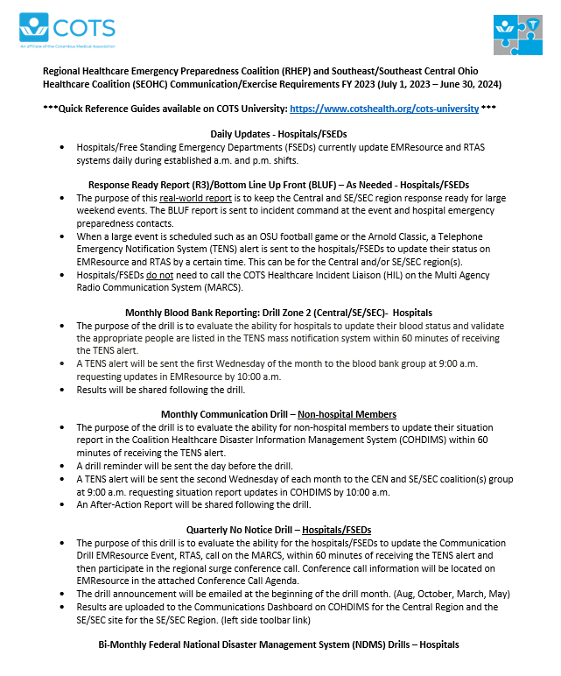
Types of exercises
Located on COTS U: https://www.cotshealth.org/cots-university
Explains the different exercise requirements.
Review together!

Slide 10
Communications Systems
Telephone Emergency Notification System (TENS) – Mass Notification System
EMResource- Statewide Bed and Event Reporting System
Real Time Activity Status (RTAS)
EMTrack- Statewide Patient Tracking System
Coalition Healthcare Disaster Information Management System (COHDIMS) – For Resource Requests and Non-Hospital Situation Report Reporting
MARCS Radios (Statewide and multi-jurisdiction)

Slide 11
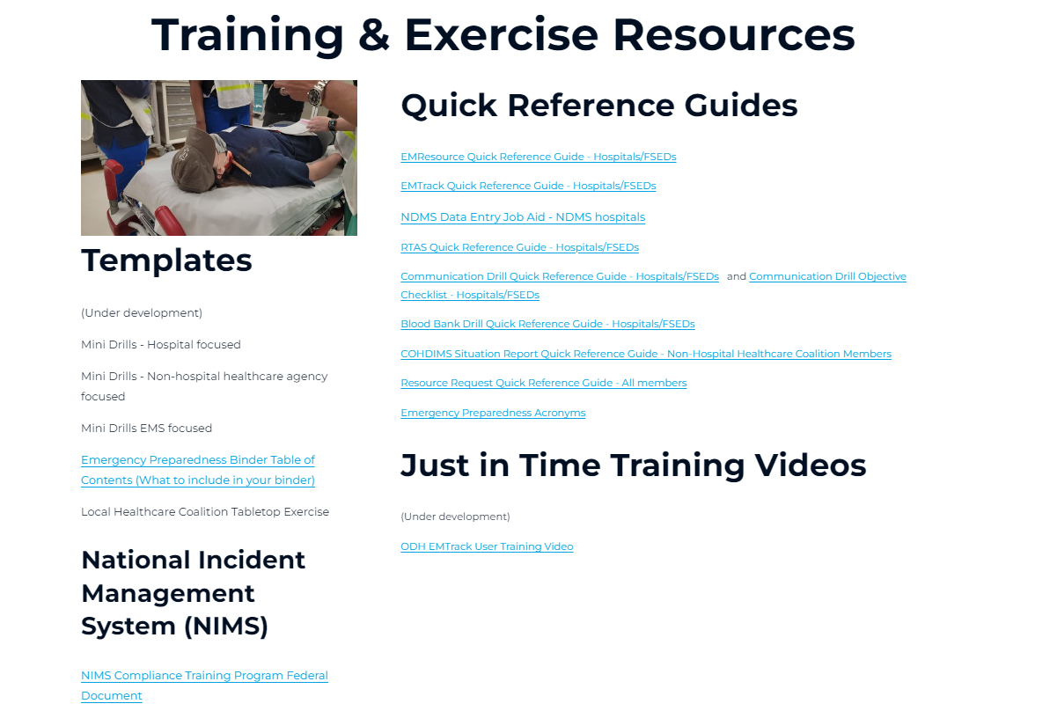
Quick Reference Guides on COTS U

Slide 12
Multi-Agency Radio Communication System (MARCS)
  Each hospital has been assigned a zone and a talkgroup.
  When we communicate regionally, we communicate on the XHOS-CEN talkgroup for the Central Region and the XHOSP-SE for the SE/SEC Regions.
  ODH conducts quarterly drills for the hospitals
  COTS conducts quarterly drills for the FSEDs

Slide 13
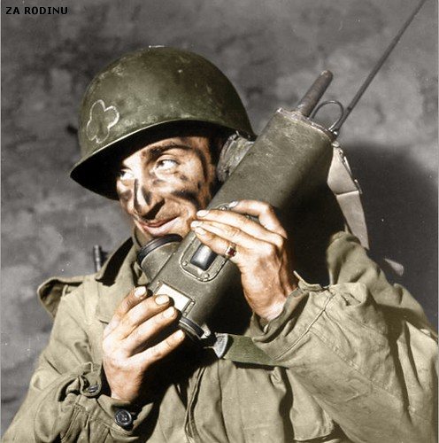
General radio etiquette
Identify:
  Civilian system: yourself first, who you are calling second
  Military model: who you are calling first, who you are second.
Politeness is assumed – no need for please or thank you
Concise to the point communication
Don’t “waste the air”
Have a “note system” for recording
Closed loop communication on orders

Slide 14
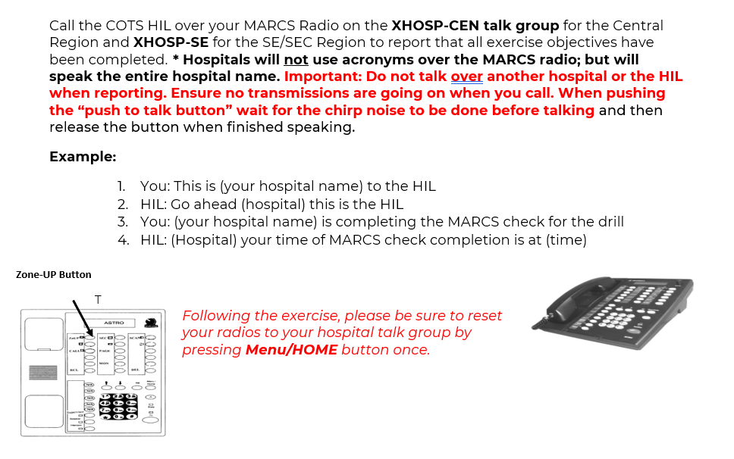
COTS Drill MARCS Objective
When the HIL confirms the check that means the MARCS objective was met. Not all the objectives. We can’t confirm all objectives are met during the drill.

Slide 15



MARCS check Example:
Using MARCS to contact COTS:
  “Grant Medical Center to COTS”
  Then pause until you hear COTS answer
  “This is COTS, go ahead Grant”
  “Grant has completed its drill requirements”
  “Grant, we have you completed at 0945. COTS clear”
Avoid using acronyms –
  i.e., NCHLC, OHP, DMH, KCH, HCH, EORH, etc.
  Use your hospitals real name

Slide 16
Drill Assistance
COTS will do our best to help drill participants during drill, but we are too busy to educate you during the drill.
If you are having issues with the systems or MARCS page the HIL during the drill and we will try to troubleshoot if we can’t help, we will mark that objectives as Out of Service (OOS).

Slide 17
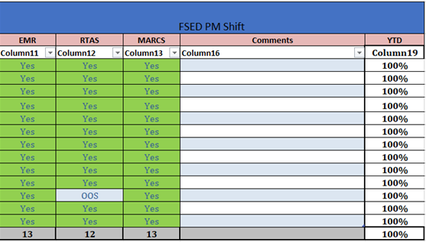
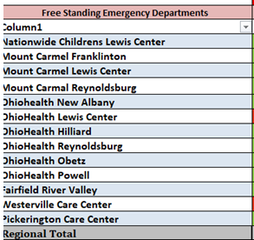
Example of After-Action Report
If any section is a “NO” = failed

Slide 18
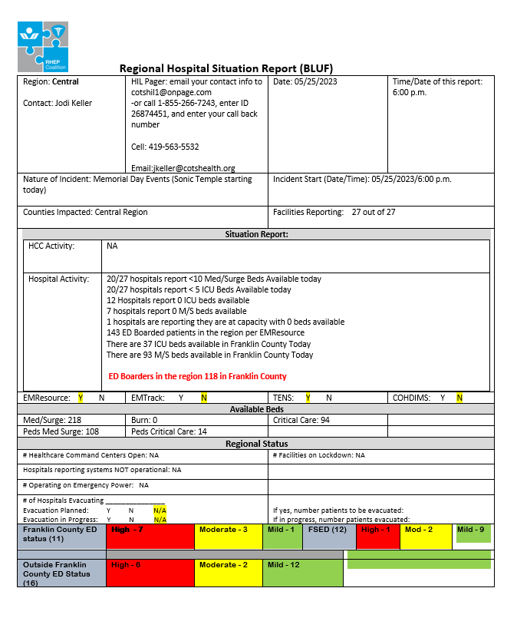
Response Ready Reports (R3)
Completed during large events (OSU football games, Red, White and Boom, etc.)
Information is shared out and a TENS alert is sent when these are occurring.
Also called the BLUF Report when it is a simple report (Bottom Line Up Front.

Slide 19


Slide 20

Thank you!
Melissa Rose, MEP
Training and Exercise Planner
COTS
mrose@cotshealth.org

